Slide 1
Ant sorting
Menno Van Damme, Yari Van Laere

Slide 2
Ant colony algorithms

Slide 3
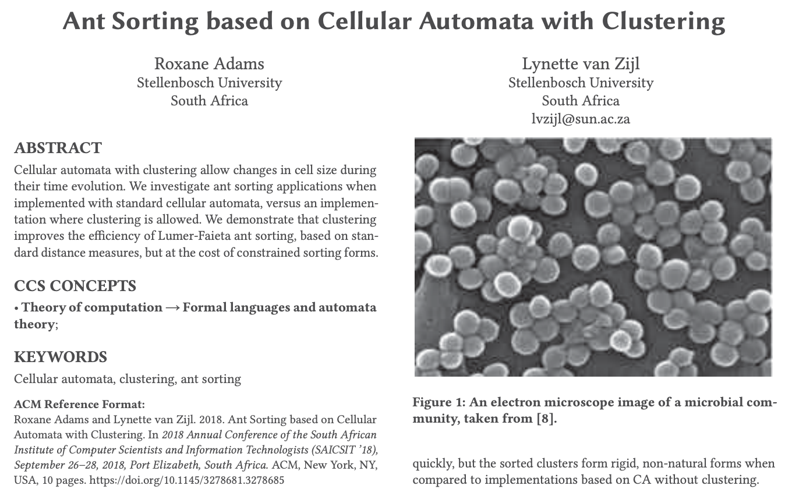
Ant sorting

Slide 4
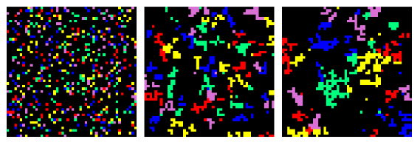

Ant sorting

Slide 5
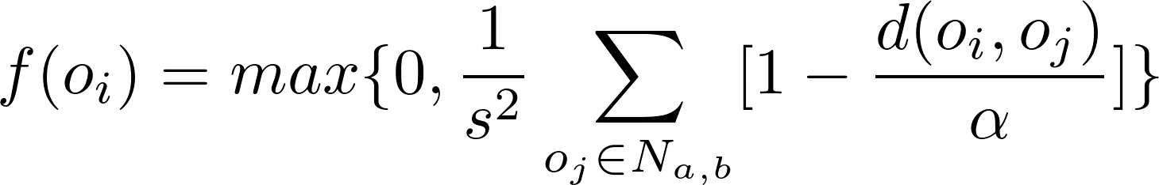
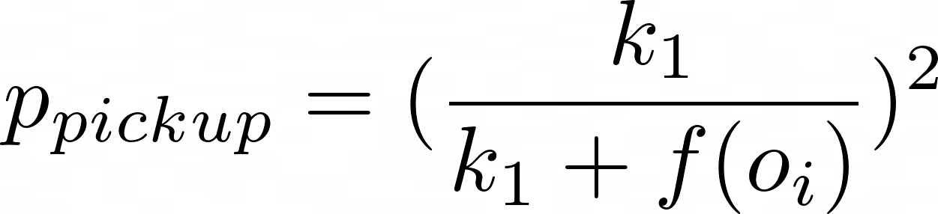
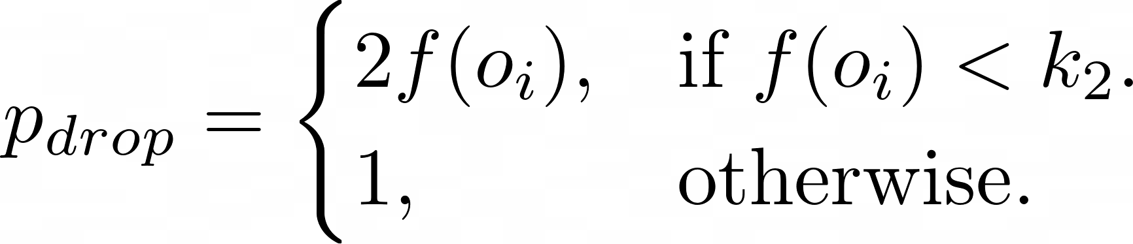
Lumer-faieta

Slide 6
Lumer-faieta

Slide 7
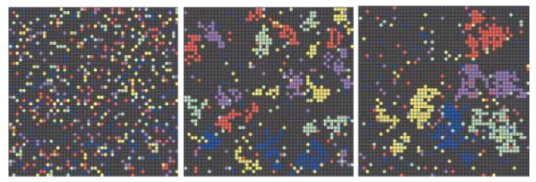
Results Lumer-Faieta
0
10 000
100 000

Slide 8
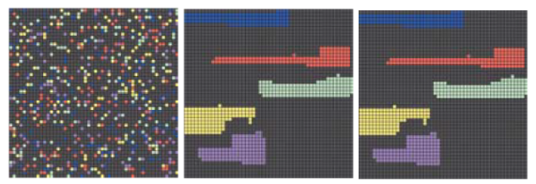
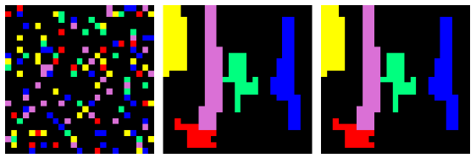
Results with clustering
0
10 000
100 000

Slide 9
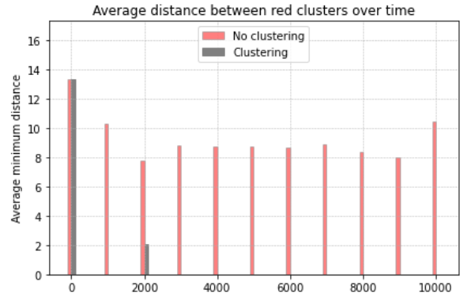
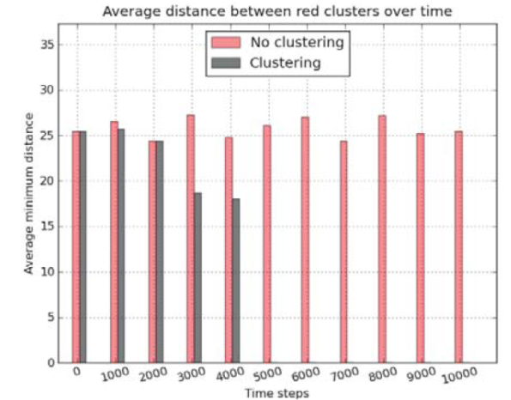
comparison

Slide 10
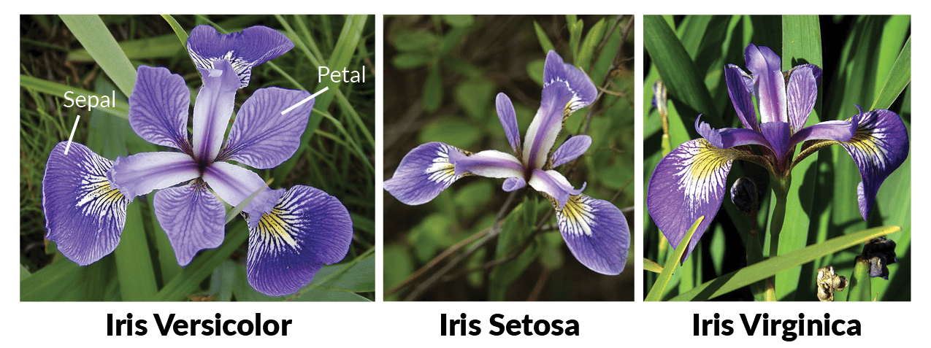
Continuous vector sorting

Slide 11
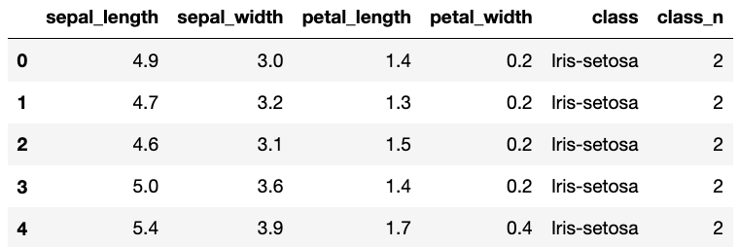
Continuous vector sorting
Notes:
Picture is a placeholder for now
The rows of the data table are the feature vectors used to sort the samples
Now that we’re working with continuous vectors there were 3 changes that need to be made: the way the dissimilarity is calculated, the value of alpha and the wlustering methid.

Slide 12
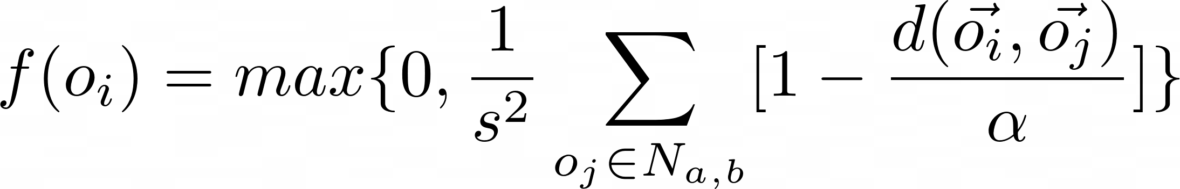
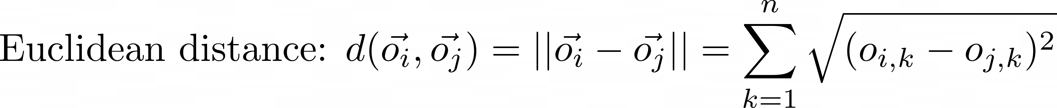
Dissimilarity
Notes:
Vectors were normalized, dissimilarity was normalized, stored in a dissimilarity matrix

Slide 13
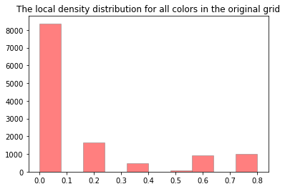
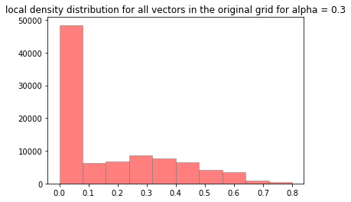
Alpha

Slide 14
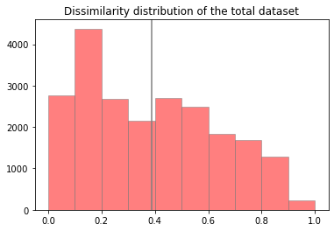
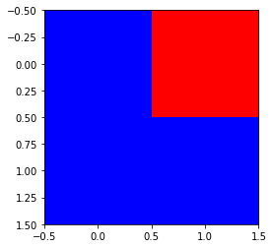
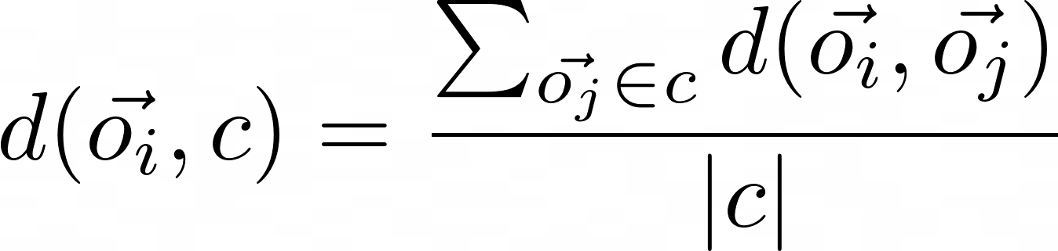
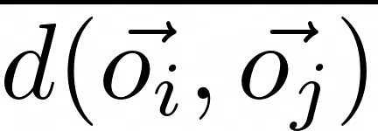
Clustering
<
Notes:
Lelijke slide :/

Slide 15
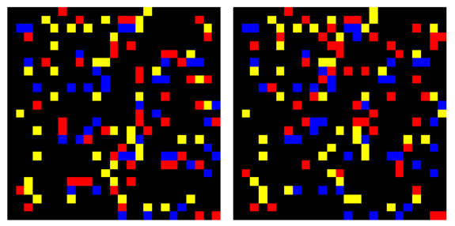
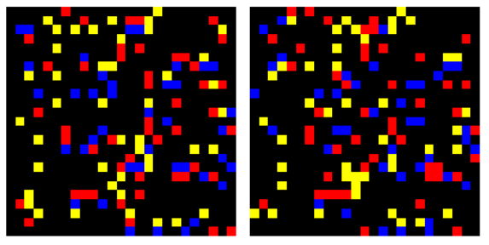
results
Lumer-Faieta without clustering
0
1 000 000
Lumer-Faieta with clustering
0
10 000

Slide 16
